Slide 1
The Impact of Human Service Organizations
A Meta-Analysis of the 2021 Emergency Rent and Utilities Assistance Programs

Slide 2
Contents
Research Issue
Research Question
Literature Review
Methodology
Findings
Discussion of Findings
Conclusions
Future Work
Acknowledgements

Slide 3
Research Issue
Statement of the problem: The paper acknowledged the uncertain relationship between the Emergency Rent Assistance program strategies during the COVID-19 pandemic and the reduction in residential eviction rates.
Purpose of the study: The paper aims to investigate the impact of Human Service Organizations (HSOs) as portrayed in the academic literature and inform the reader about trends, thematic patterns, and knowledge gaps that must be addressed for future policies and strategies aiming at preventing residential evictions to be effective.

Slide 4
Research Question
How effective are Human Service Organizations in providing housing and temporary aid for families?
Particularly, how effective were the 2021 ERA programs in this regard?

Slide 5
Literature Review
Theoretical Foundations
Organizational Challenges and Work Culture Impact
Service Integration and Capacity Building
Knowledge Management
Organizational Resilience
COVID-19 Challenges: System Transformation
Trends and Future Directions

Slide 6
Methodology
Research Design Overview
Meta-Analysis Approach
Study Selection Criteria
Data Extraction
Analytical Techniques
Findings Interpretation
Ethical Considerations
Limitations
Notes:
A qualitative meta-analysis of existing literature was conducted, considering reported outcomes, perceived impacts, and qualitative data while acknowledging potential biases in interpretation and the differences between portrayed and actual effectiveness.

Slide 7
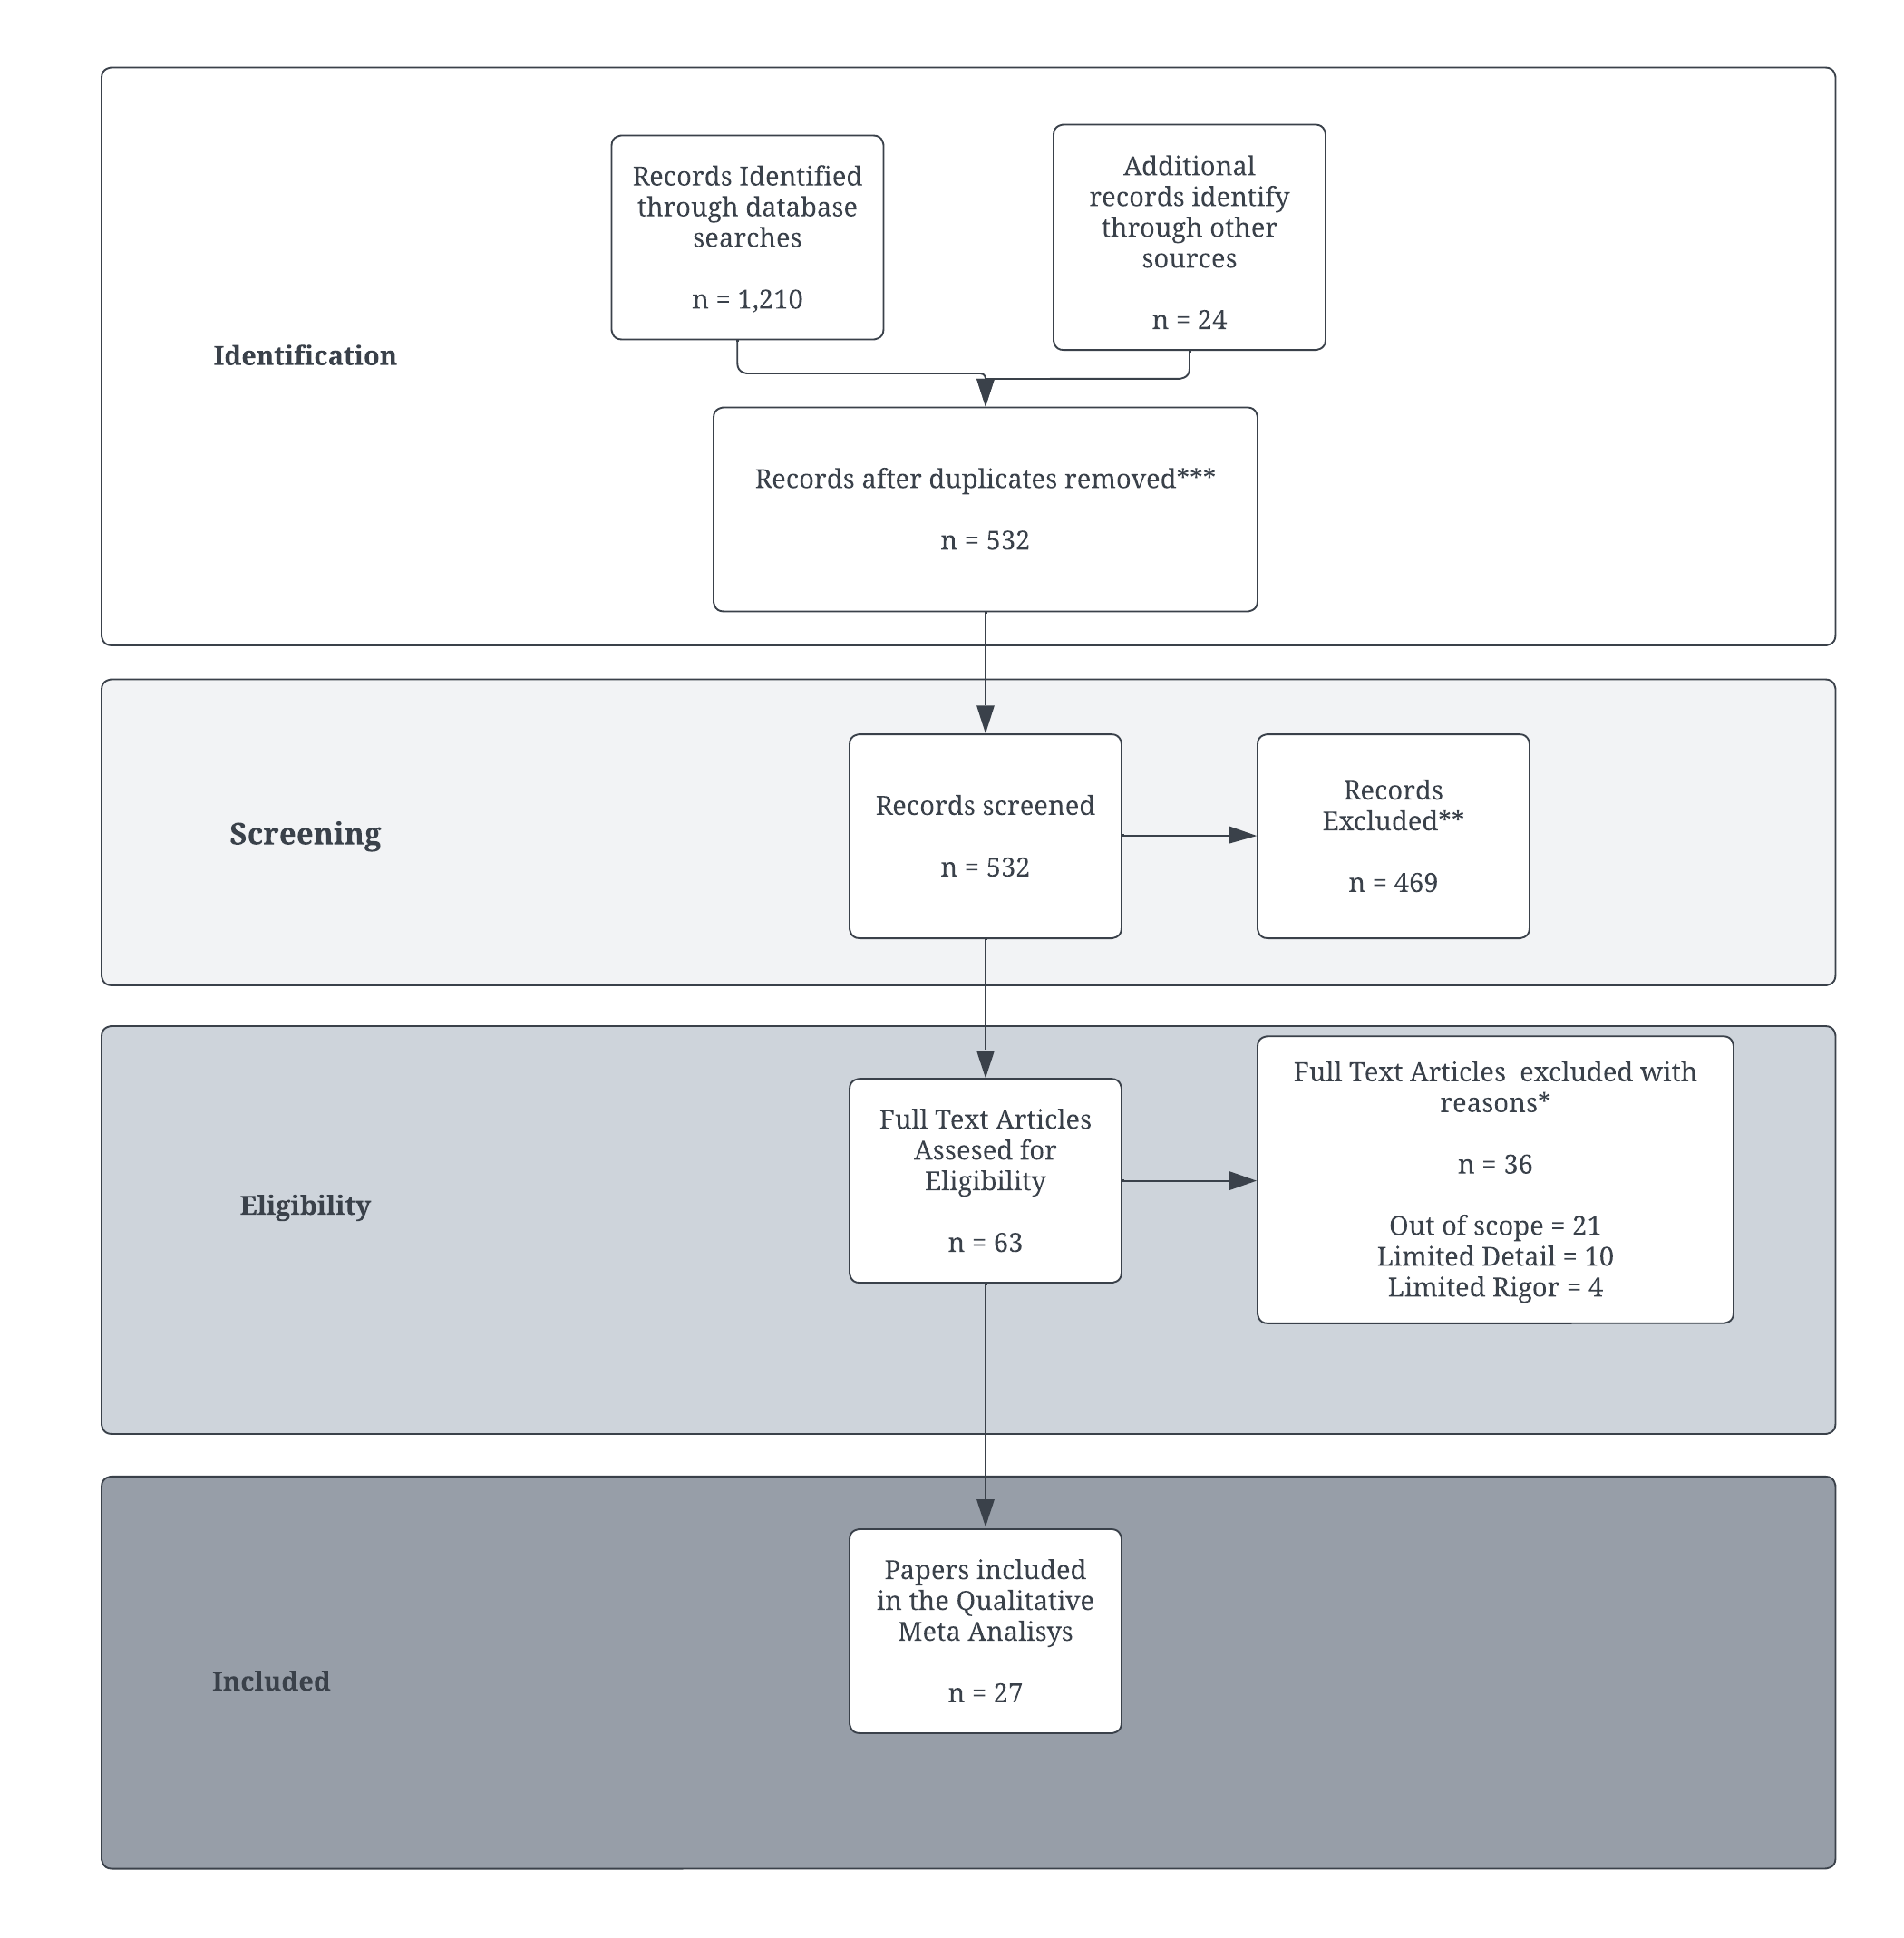
Methodology
Notes:
PRISMA (Preferred Reporting Items for Systematic Reviews and Meta-Analyses) is a widely recognized guideline for conducting systematic reviews and meta-analyses in research. It provides a structured approach to document selection processes, ensuring transparency and reproducibility in the review process.

Slide 8
Findings
Key findings are about thematic patterns. The studies converge on the following points. HSOs need to adapt to evolving circumstances quickly, consider location-specific strategies, direct resources to areas of greatest need, and consider equity in their work.
The studies also emphasized the role of rental assistance programs in mitigating the negative effects of the public health measures against the pandemic.

Slide 9
Findings
The findings from individual studies further underscored the disproportionate impact of the pandemic on low-income renters, the limited impact of federal fiscal assistance, and the need for rental assistance in maintaining housing stability during the pandemic.

Slide 10
Conclusions
The author found that while data on Human Service Organizations (HSOs) is plentiful, it is scattered across sources.
Effective HSO strategies include addressing rent arrears, providing financial support to tenants, and creating programs to prevent eviction.

Slide 11
Conclusions
HSOs were important in addressing housing issues during the COVID-19 pandemic, particularly through rental assistance programs.
The findings suggest that HSOs effectively increase housing stability and reduce the increasing number of residential evictions, as demonstrated by the outcomes of the Emergency Rent and Utilities Assistance Program (ERAP).

Slide 12

Future Work
Identifying strategies for strengthening collaborations among HSOs, adapting to socio-economic changes, prioritizing resources to areas of greater need, and further researching effective strategies to reduce residential evictions.
Research questions for future projects could focus on case studies of effective collaborations, the impact of socio-economic changes on ERA programs, methods for identifying areas of greater need, and effective eviction prevention strategies in specific regions.
The most promising opportunity lies in strengthening collaborations among HSOs for more effective eviction prevention.

Slide 13
Acknowledgments
The author extends gratitude to colleagues for their invaluable assistance during class discussions.
Special recognition is given to Dr. Kenneth Goldberg for his insightful critique of this project and timely feedback.

